Slide 1
An Amazon Product Classifier
Nick Gigliotti

Slide 2

Business Problem
Amazon has asked me to build a product classifier for two purposes:
Integrating new products
Flagging misclassified products
They would like some recommendations pertaining to the product classifier and its uses.

Slide 3
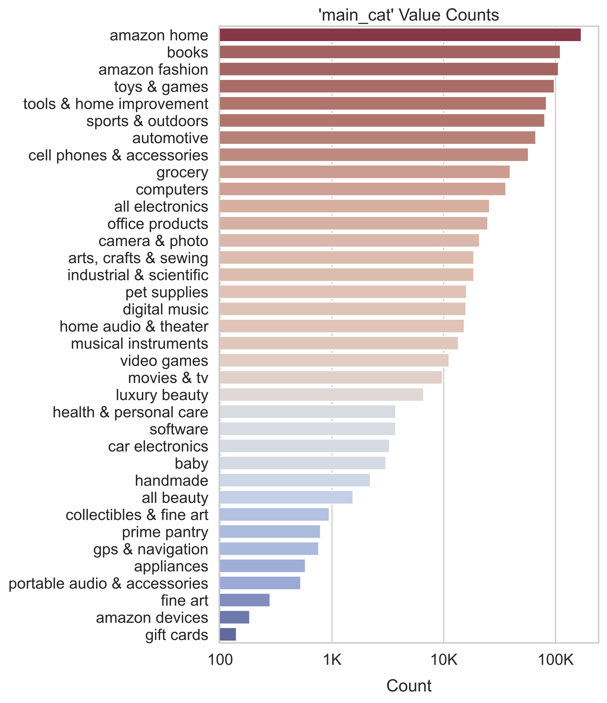
Dataset
The dataset was originally gathered by three AI researchers, Jianmo Ni, Jiacheng Li, and Julian McAuley, for their 2019 paper, “Justifying Recommendations Using Distantly-Labeled Reviews and Fine-Grained Aspects.”
Originally contains ~15M Amazon products (~13GB)
Reduced to ~1M by extensive scrubbing and engineering
36 classes, imbalanced
Includes title, description, brand, feature, and category
Probably scraped (contains HTML tags)
Released/updated in 2018

Slide 4
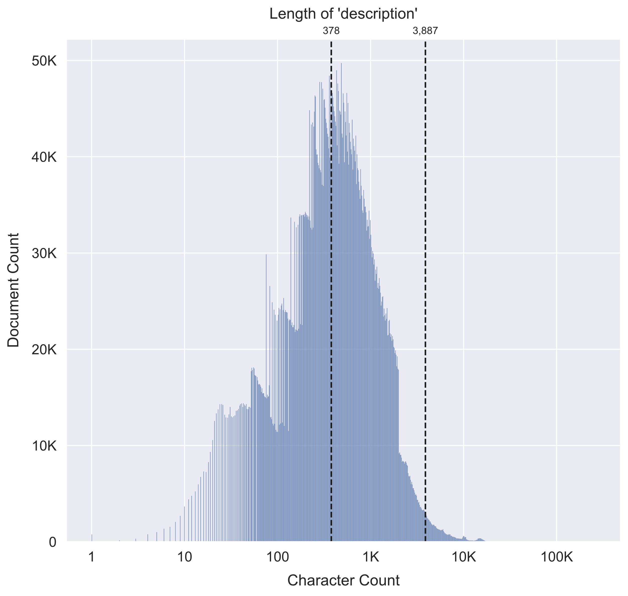
Methods
Curate corpus for model training:
Drop shortest 50% of descriptions
Drop extremely long outliers
Select only top brands in each category
Rigorous preprocessing:
Filter out non-ASCII, numerals, punctuation
Filter out stop words, repetitive sequences
Restrict token length (2-16 characters)
Feature engineering:
Multi-word brand terms
Extract bigrams (2-word phrases) from each category
Binary TF*IDF vectorization
Binary occurrence markers {0, 1}
IDF weighting to emphasize rare terms
Normalize to reduce effect of document length
Support Vector Machine with SGD
Efficient on large datasets with 1M or more documents
Normalize to reduce effect of document length

Slide 5
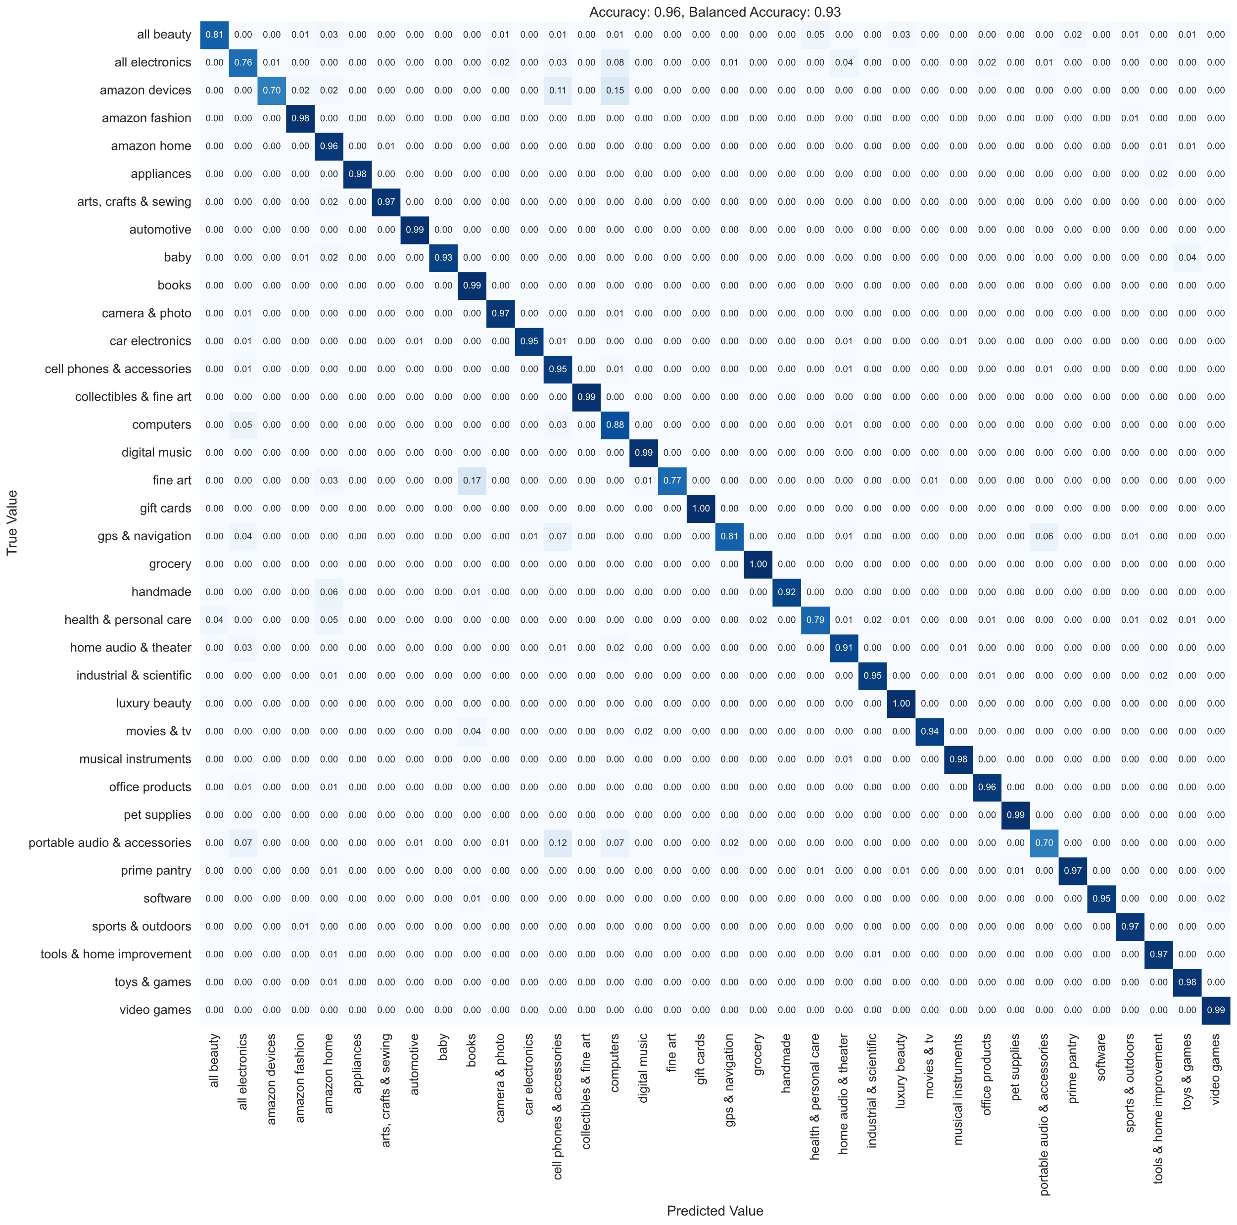
Final Model
Correct 96% of the Time
Does well on small classes
Best class recall is 100%
Worst class recall is 70%
Understandable Mistakes
No egregious errors
Portable Audio → Cell Phones
Fine Art → Books
Amazon Devices → Computers, Cell Phones
Perfectionistic Learning
Learning rate is “adaptive”
Whenever quality of fit plateaus, learning continues at 1/5 of the rate

Slide 6
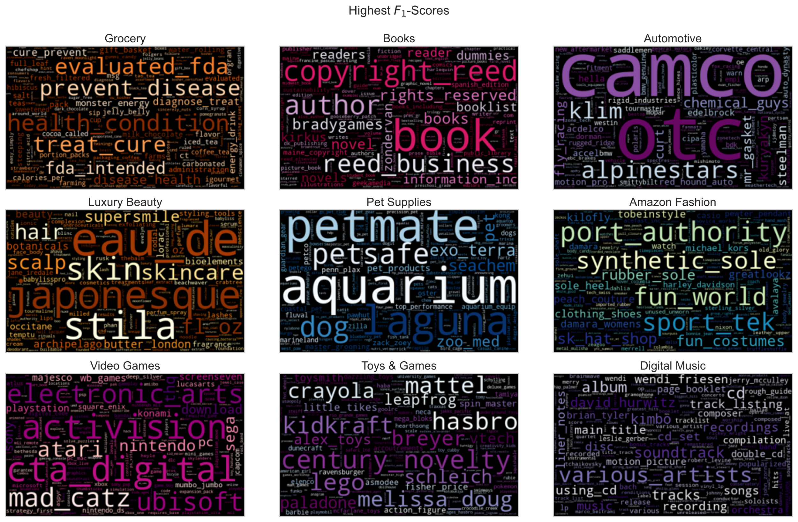
Fine Print
Brands
Mixture

Slide 7
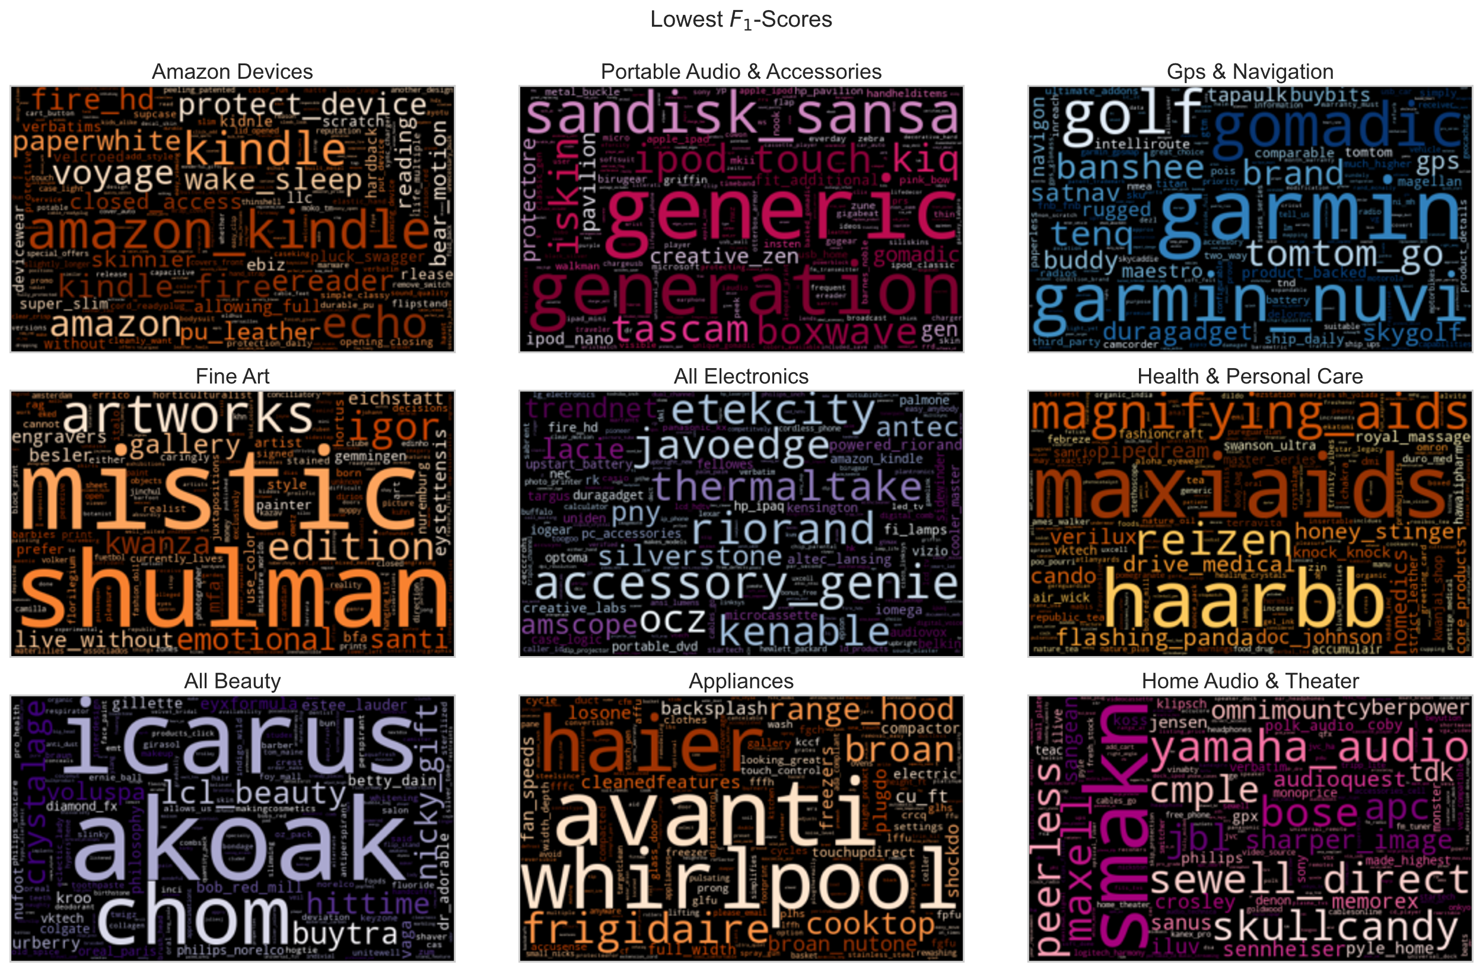
Top terms are mostly brand names
Still look good
Not too different from the top scores

Slide 8
Conclusion
If you're looking to classify products with NLP, lead with the brand terms.
Brand terms ranked high in nearly every category. One could build a decent model with *only* brand terms, though I wouldn't recommend going that far. Even if you wanted an image-based classifier, brands are the first place I'd start.
Don’t ignore boilerplate legalistic text, because sometimes it’s category-specific.
In fact, I recommend you gather up all the legalistic caveats and copyright statements you can get. This text is sometimes very distinctive of its category.
Use the model to study your competitors and scope out new suppliers.
This model can be used to analyze other business' inventories, including those of competitors. Discover new products and suppliers by directly comparing their inventories to yours under your classification scheme.

Slide 9
Looking Forward
- Gather data on brands concerning their relationships and parent companies.
- Try to expand the model's coverage to more obscure brands.
- Develop a workflow to create specialized subcategory models for each major category.
- These will be multilabel classification models.
- Create a dashboard to demonstrate the accuracy and rich interpretability of the model.
- Obtain a new, unseen dataset to test the model's generalizability.

Slide 10
Thanks
Nick Gigliotti
github.com/ndgigliotti

